Slide 1



Sales report1
View in Power BI
Last data refresh:
8/19/2024 4:31:53 PM UTC
Downloaded at:
8/19/2024 4:50:52 PM UTC

Slide 2
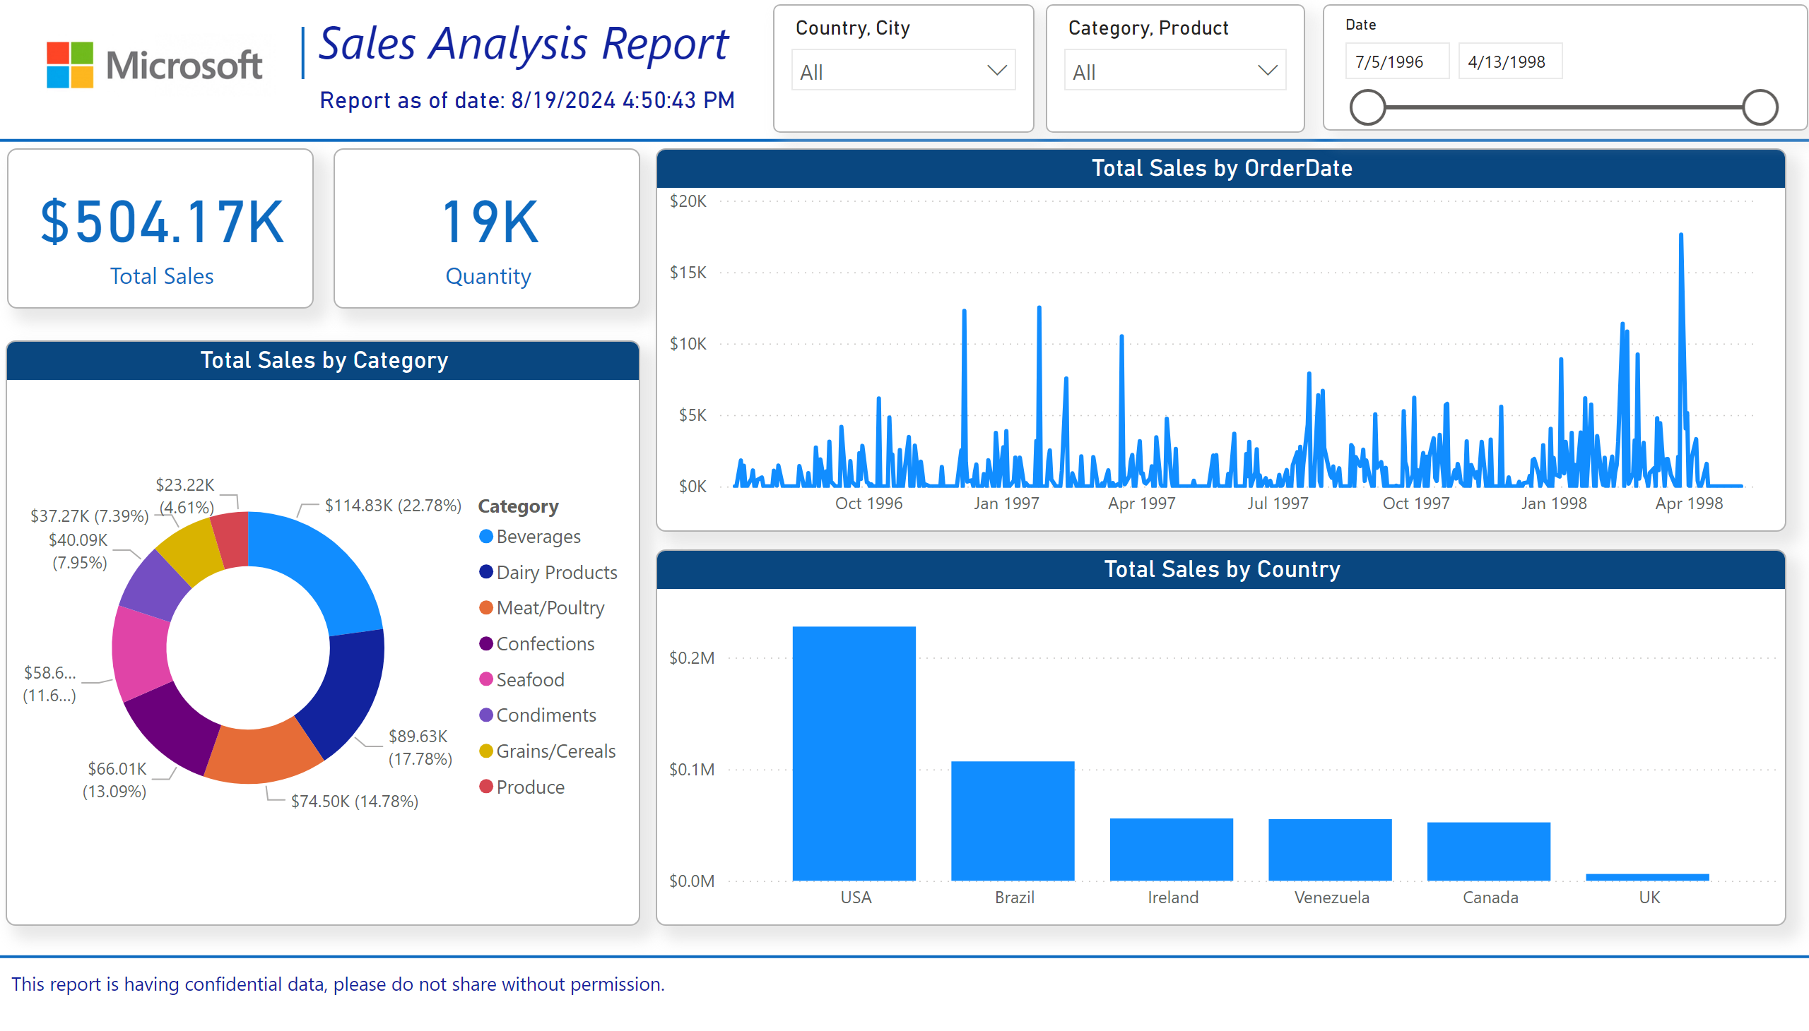
Summary
Notes:
shape
No alt text provided
shape
No alt text provided
image
No alt text provided
shape
No alt text provided
textbox
No alt text provided
card
No alt text provided
textbox
No alt text provided
card
No alt text provided
card
No alt text provided
donutChart
No alt text provided
slicer
No alt text provided
slicer
No alt text provided
lineChart
No alt text provided
slicer
No alt text provided
columnChart
No alt text provided
areaChart
No alt text provided
shape
No alt text provided

Slide 3
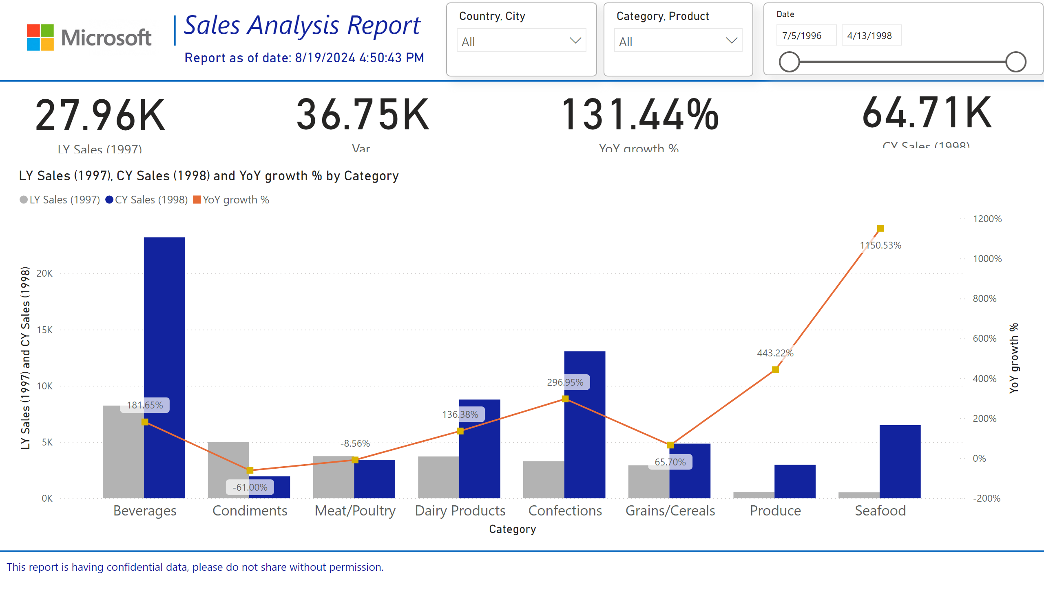
CY vs LY
Notes:
card
No alt text provided
card
No alt text provided
card
No alt text provided
card
No alt text provided
lineClusteredColumnComboChart
No alt text provided
image
No alt text provided
shape
No alt text provided
textbox
No alt text provided
card
No alt text provided
slicer
No alt text provided
slicer
No alt text provided
shape
No alt text provided
slicer
No alt text provided
textbox
No alt text provided
shape
No alt text provided

Slide 4
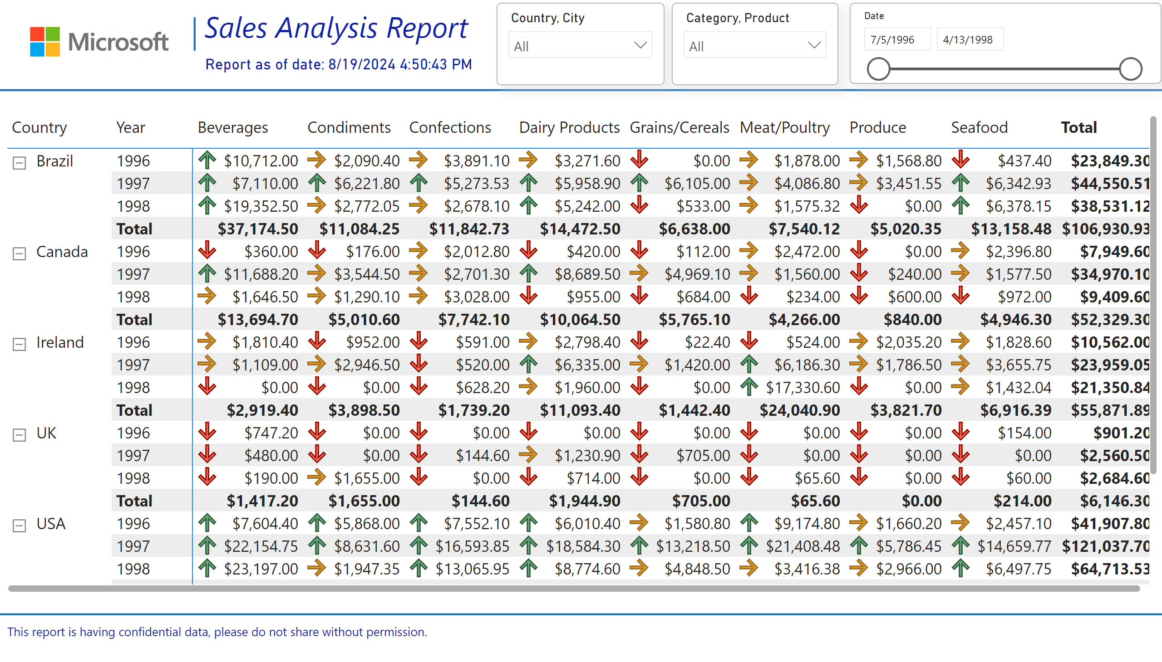
Details
Notes:
shape
No alt text provided
shape
No alt text provided
image
No alt text provided
shape
No alt text provided
textbox
No alt text provided
card
No alt text provided
textbox
No alt text provided
slicer
No alt text provided
pivotTable
No alt text provided
slicer
No alt text provided
slicer
No alt text provided

Slide 5
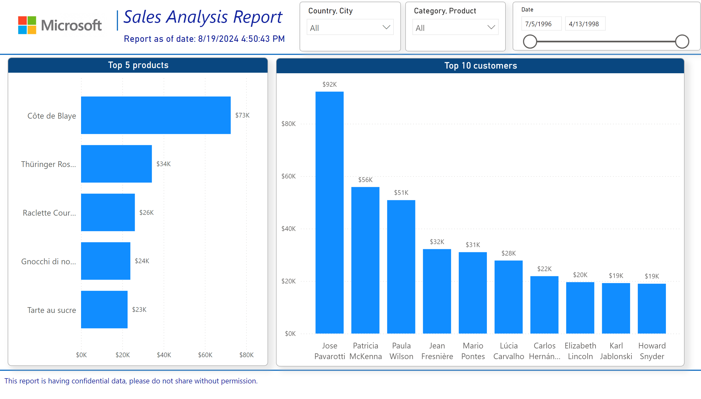
Top Products/Customers
Notes:
shape
No alt text provided
shape
No alt text provided
image
No alt text provided
shape
No alt text provided
textbox
No alt text provided
card
No alt text provided
textbox
No alt text provided
slicer
No alt text provided
slicer
No alt text provided
slicer
No alt text provided
Top 5 products
No alt text provided
Top 10 customers
No alt text provided

Slide 6
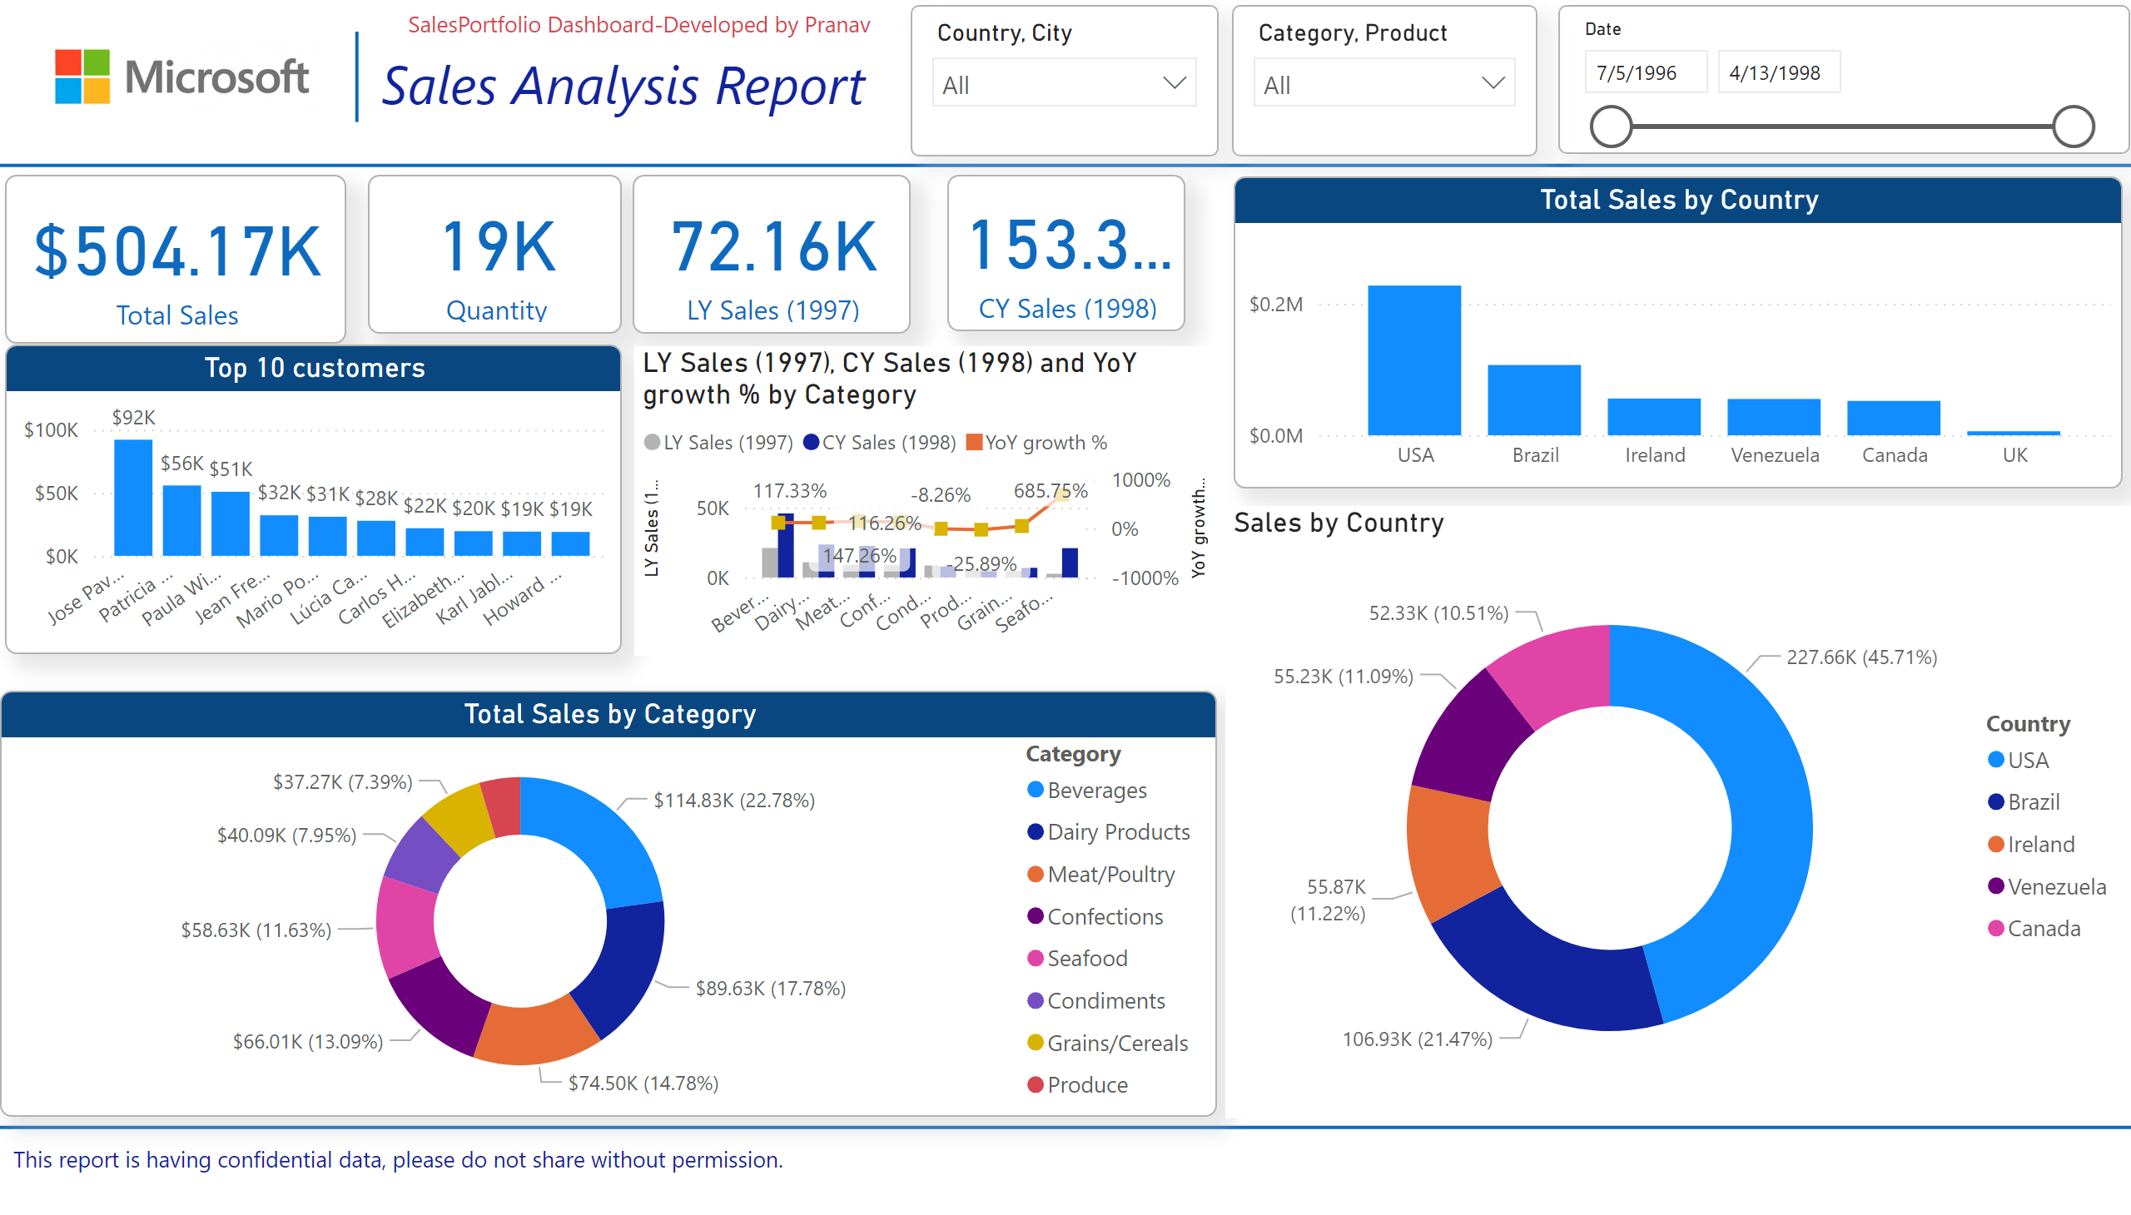
Sales Portfolio Dashboard-Pranav Prakash
Notes:
card
No alt text provided
card
No alt text provided
card
No alt text provided
card
No alt text provided
Top 10 customers
No alt text provided
lineClusteredColumnComboChart
No alt text provided
donutChart
No alt text provided
columnChart
No alt text provided
shape
No alt text provided
shape
No alt text provided
image
No alt text provided
shape
No alt text provided
textbox
No alt text provided
textbox
No alt text provided
slicer
No alt text provided
slicer
No alt text provided
slicer
No alt text provided
donutChart
No alt text provided

